Slide 1



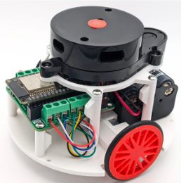
RoboTeach
Prepared By: Erik, Zaid, Rishi, and Cira
Hackathon 2025
www.reallygreatsite.com

Slide 2
Introduction
RoboTeach is a learning robot that makes coding fun and simple for kids aged 5–7. Using voice recognition, children send commands and physically execute actions, strengthening laterality and spatial reasoning while learning to code. Unlike Scratch or other robot kits, RoboTeach is mobile-first, easy to use, and works both at home and in schools. Kids gain confidence and joy, parents see real STEM learning, and teachers get an affordable, curriculum-ready tool.

Slide 3
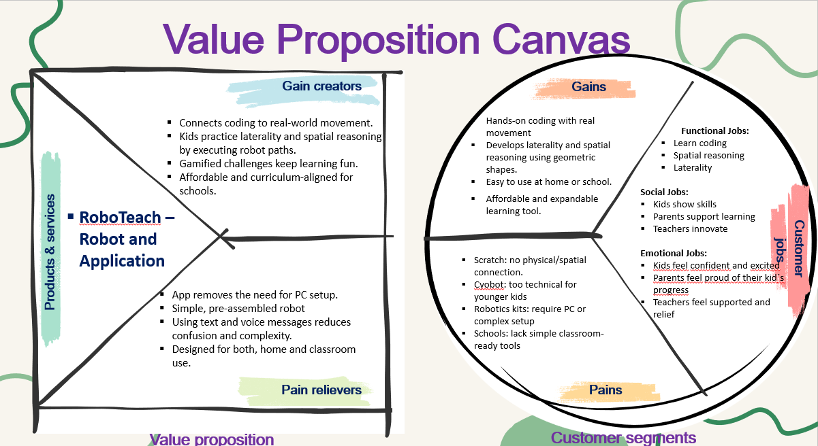
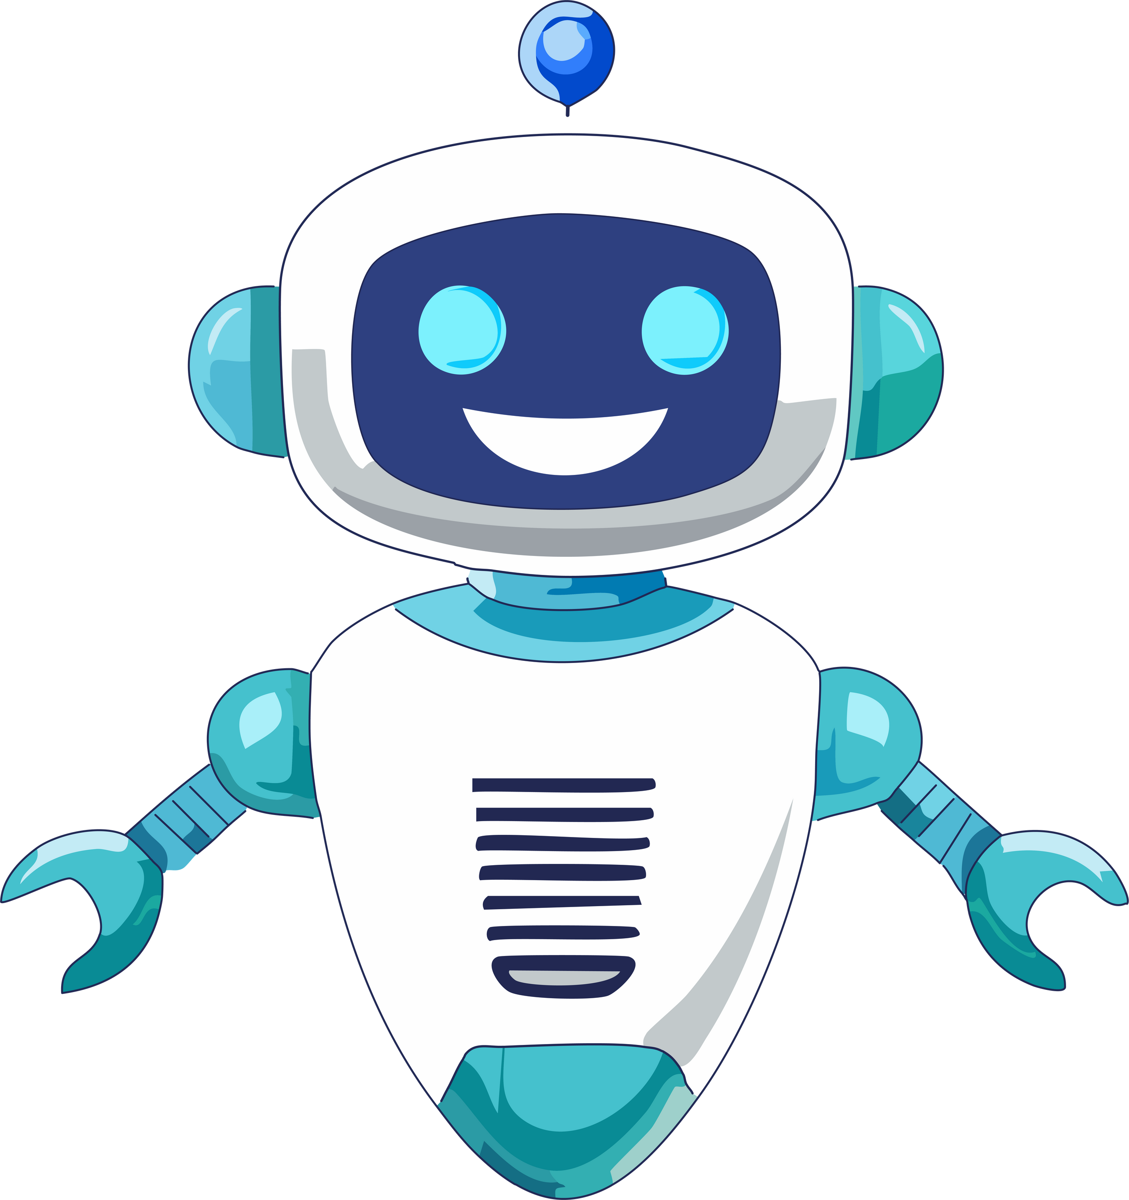
Value Proposition Canvas

Slide 4
